Slide 1

MAIZE CITY COUNCIL
REGULAR MEETING
PUBLIC BUILDING COMMISSION MEETING
SEPTEMBER 21, 2015

Slide 2
1) Call to Order
AGENDA

Slide 3
1) Call to Order

Slide 4
2) Roll Call

Slide 5
3) Pledge of Allegiance/
Moment of Silence

Slide 6
4) APPROVAL OF AGENDA

Slide 7
5) Public Comments

Slide 8
6) Consent Agenda

Slide 9
RECESS CITY COUNCIL MEETING
AND
CONVENE MAIZE PUBLIC BUILDING COMMISSION MEETING

Slide 10
MPBC AGENDA
1) CALL TO ORDER

Slide 11
2) ROLL CALL

Slide 12
3) APPROVAL OF AGENDA

Slide 13
4) APPROVAL OF MINUTES

Slide 14
5) NEW BUSINESS

Slide 15
5A) BIDS AND SALE OF MPBC BONDS FOR THE PUBLIC WORKS BUILDING

Slide 16
6) ADJOURNMENT

Slide 17
RECONVENE CITY COUNCIL MEETING

Slide 18
7) Old Business

Slide 19
7A) City Approving Ordinance MPBC Bonds and Lease

Slide 20
8) New Business

Slide 21
8A) Zoning Case Z-03-015

Slide 22
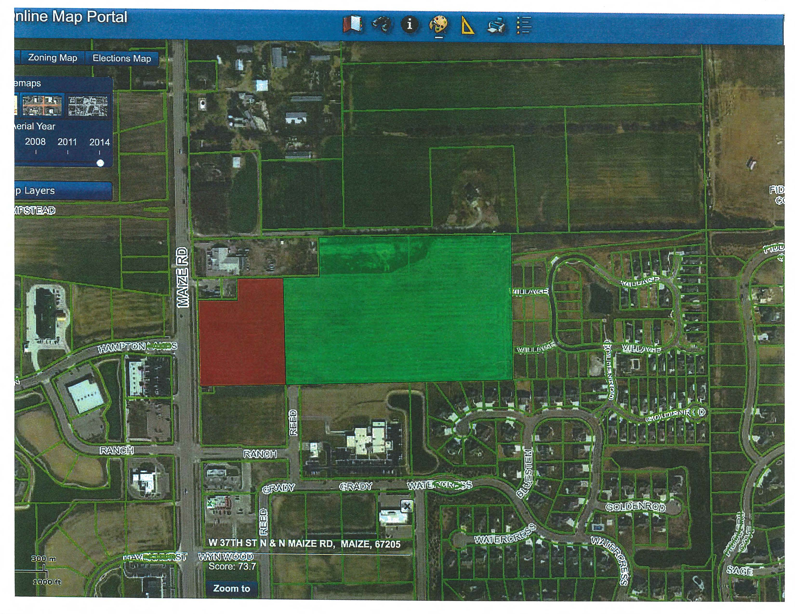

Slide 23
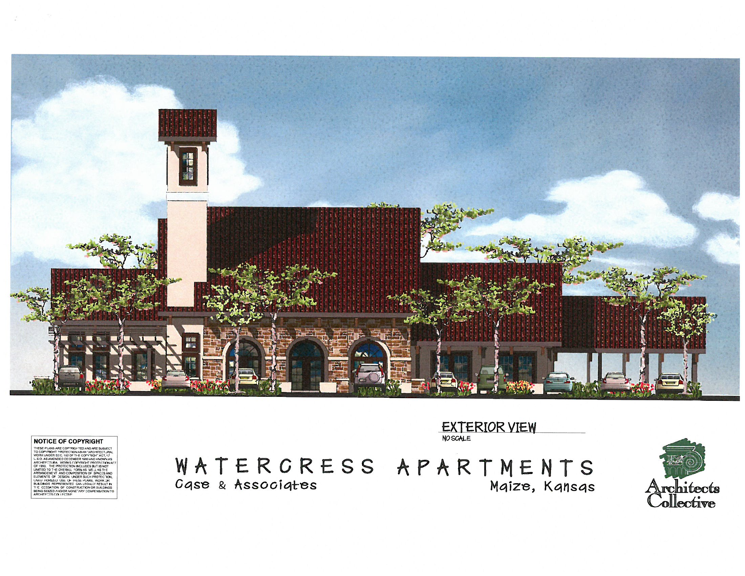
Clubhouse

Slide 24
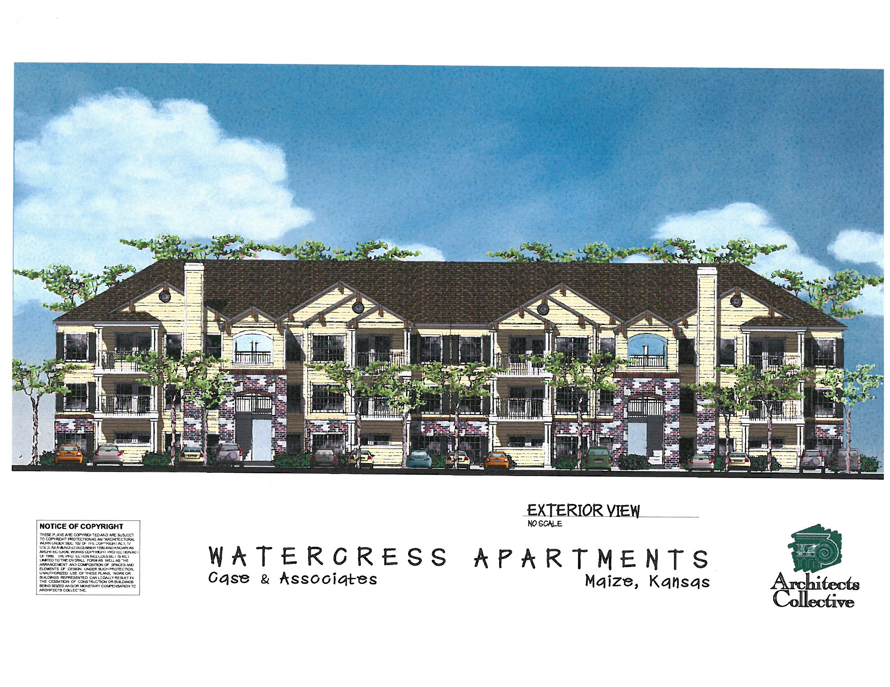
A2

Slide 25
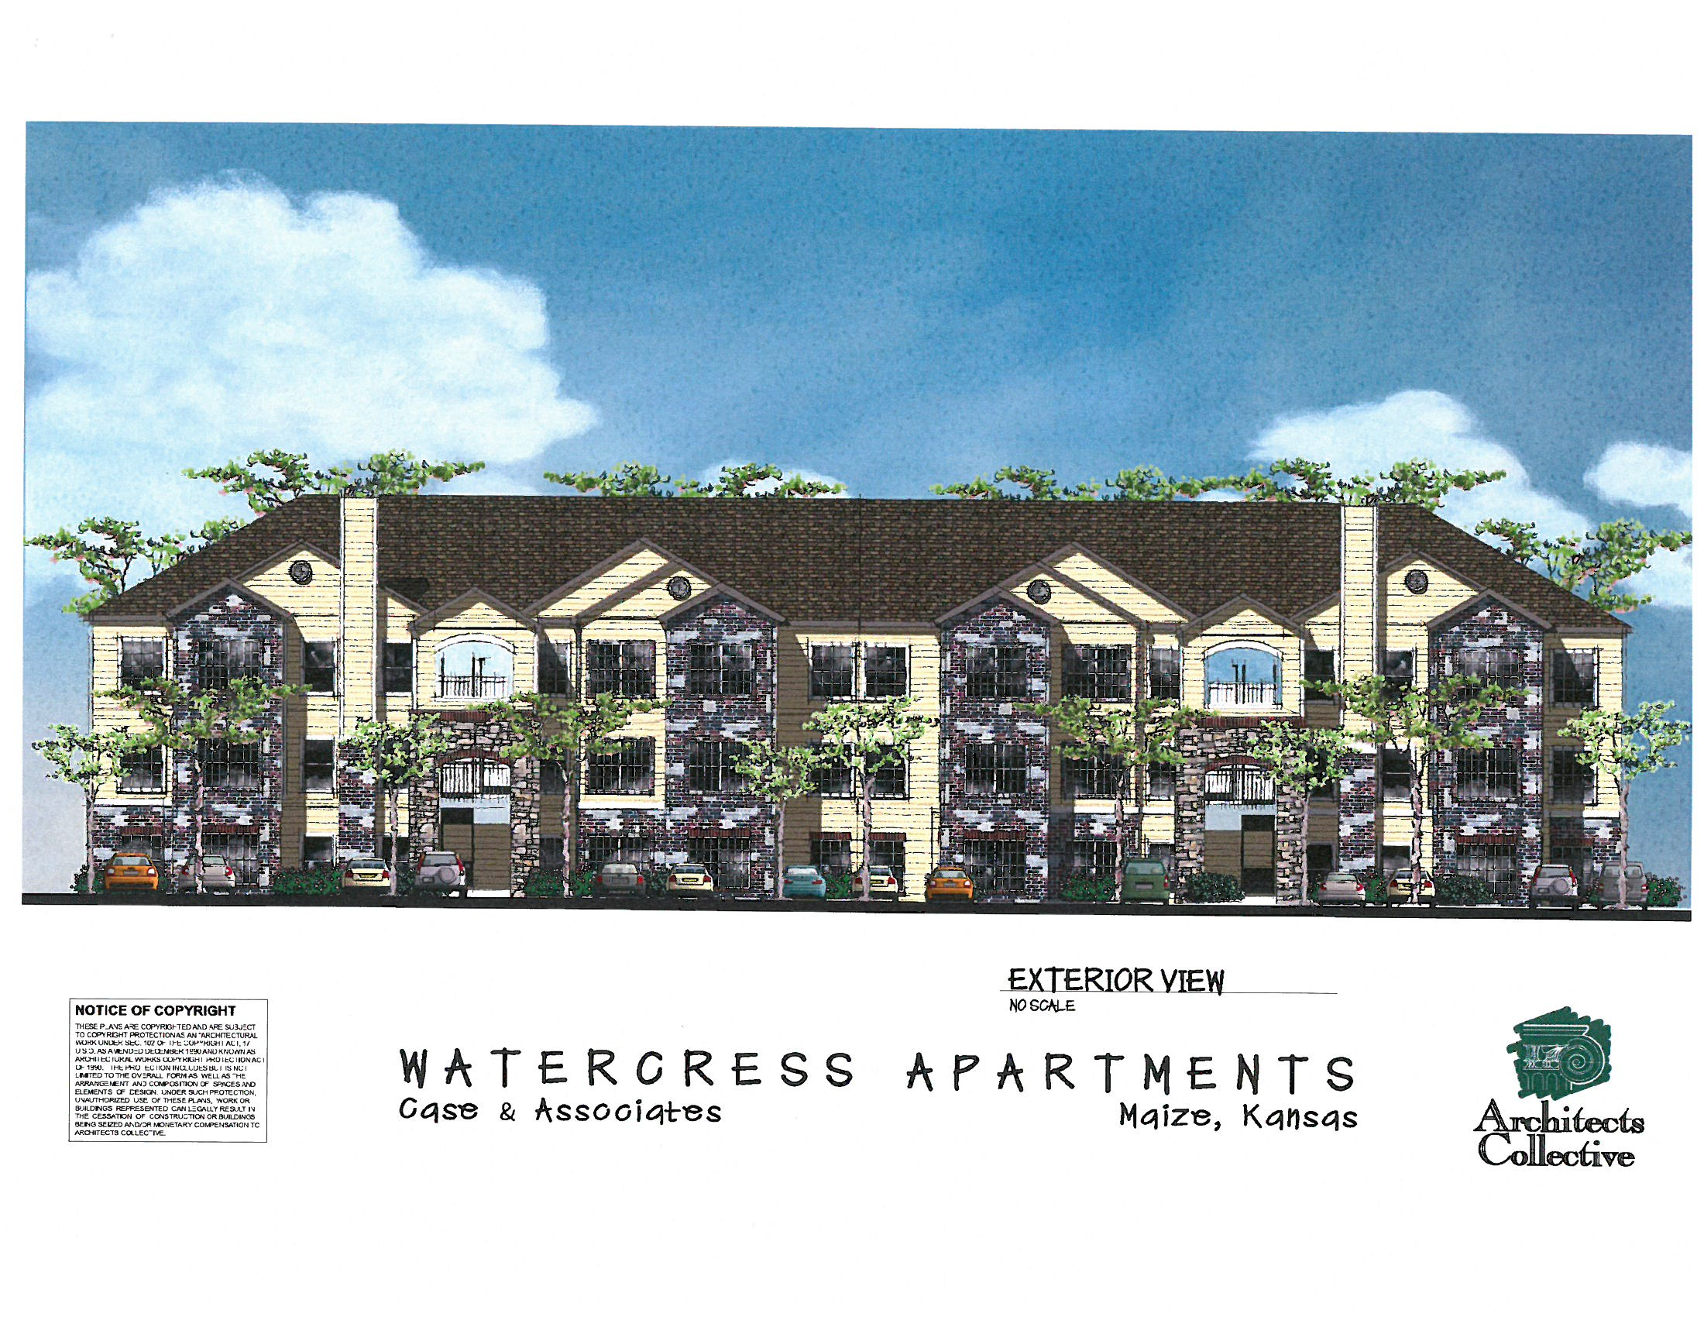
A8

Slide 26
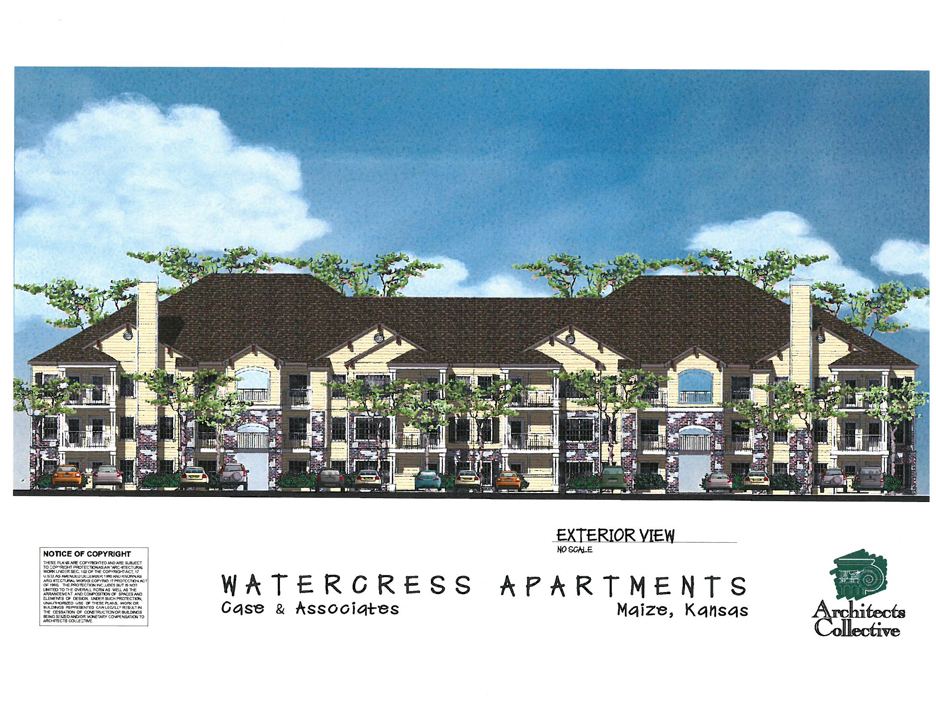
B2

Slide 27
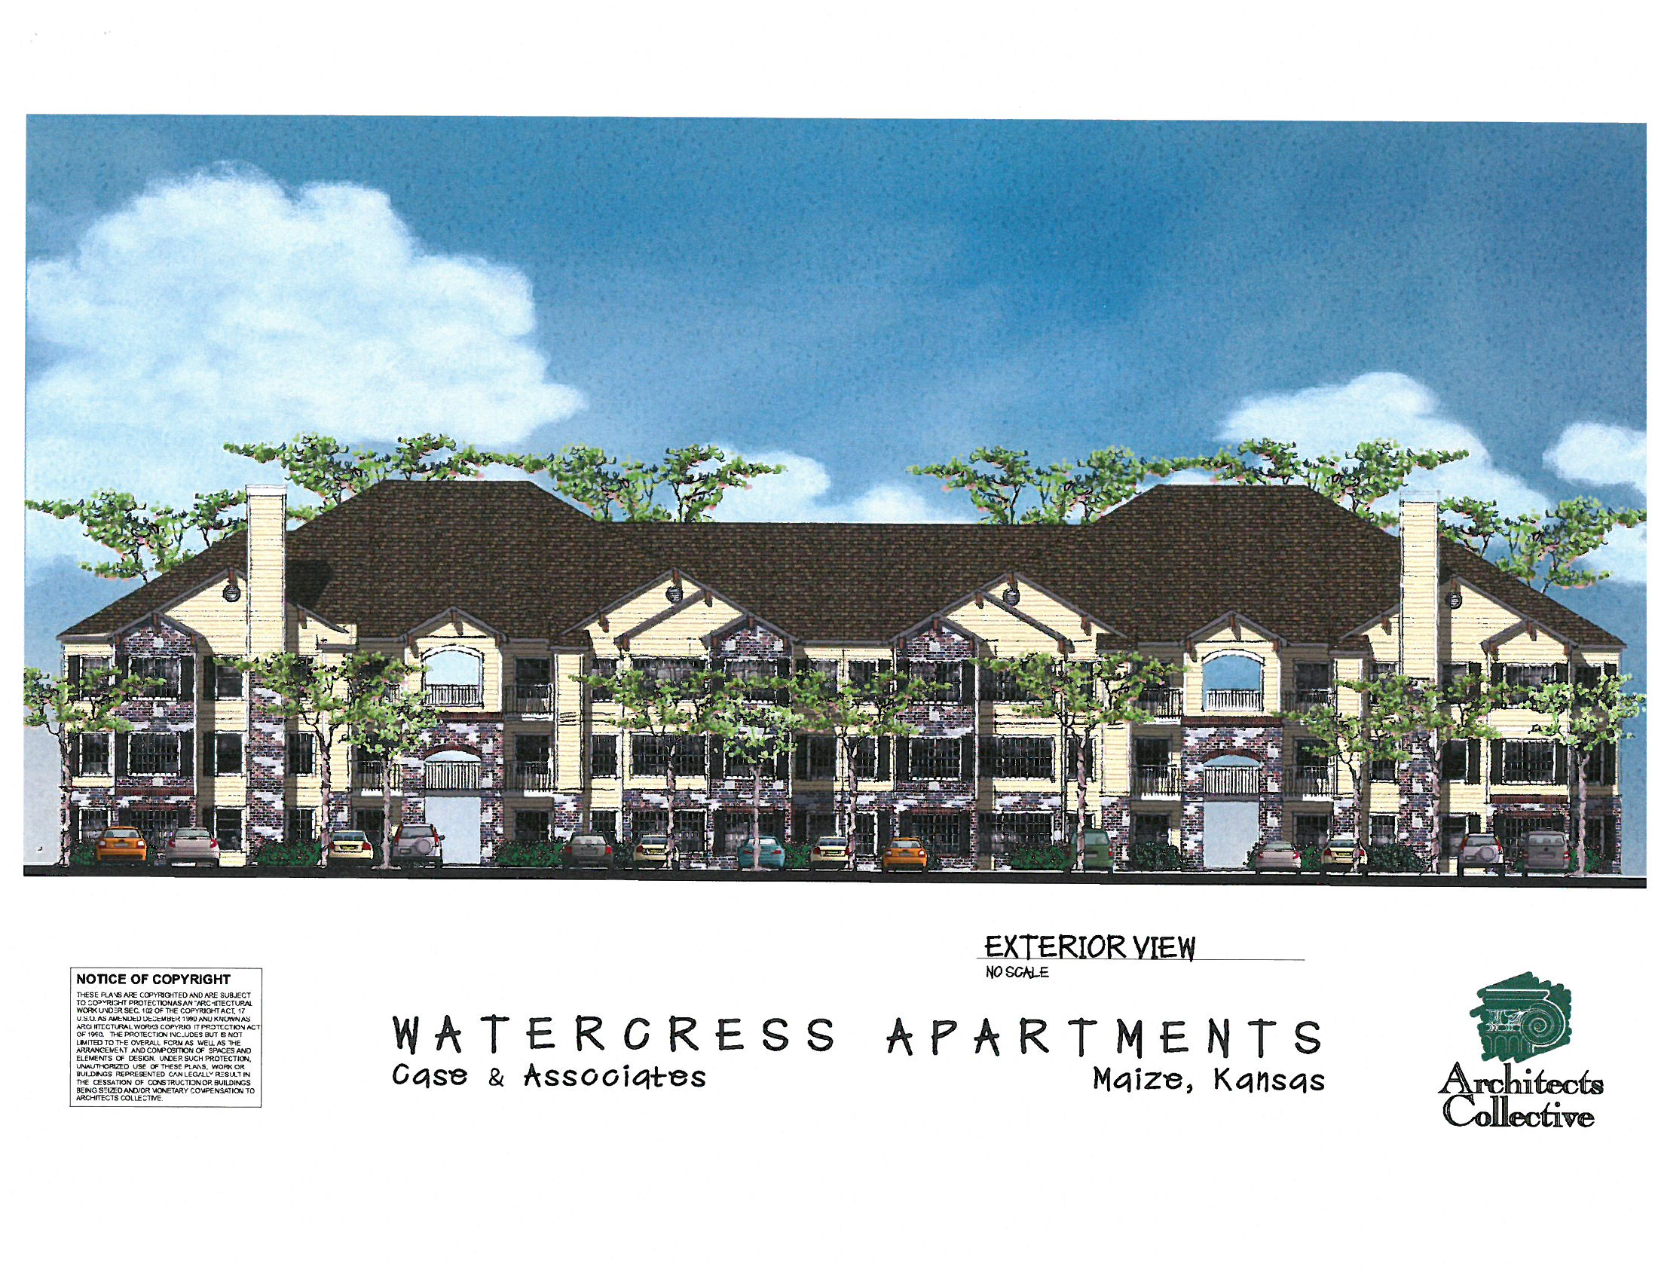
B8

Slide 28
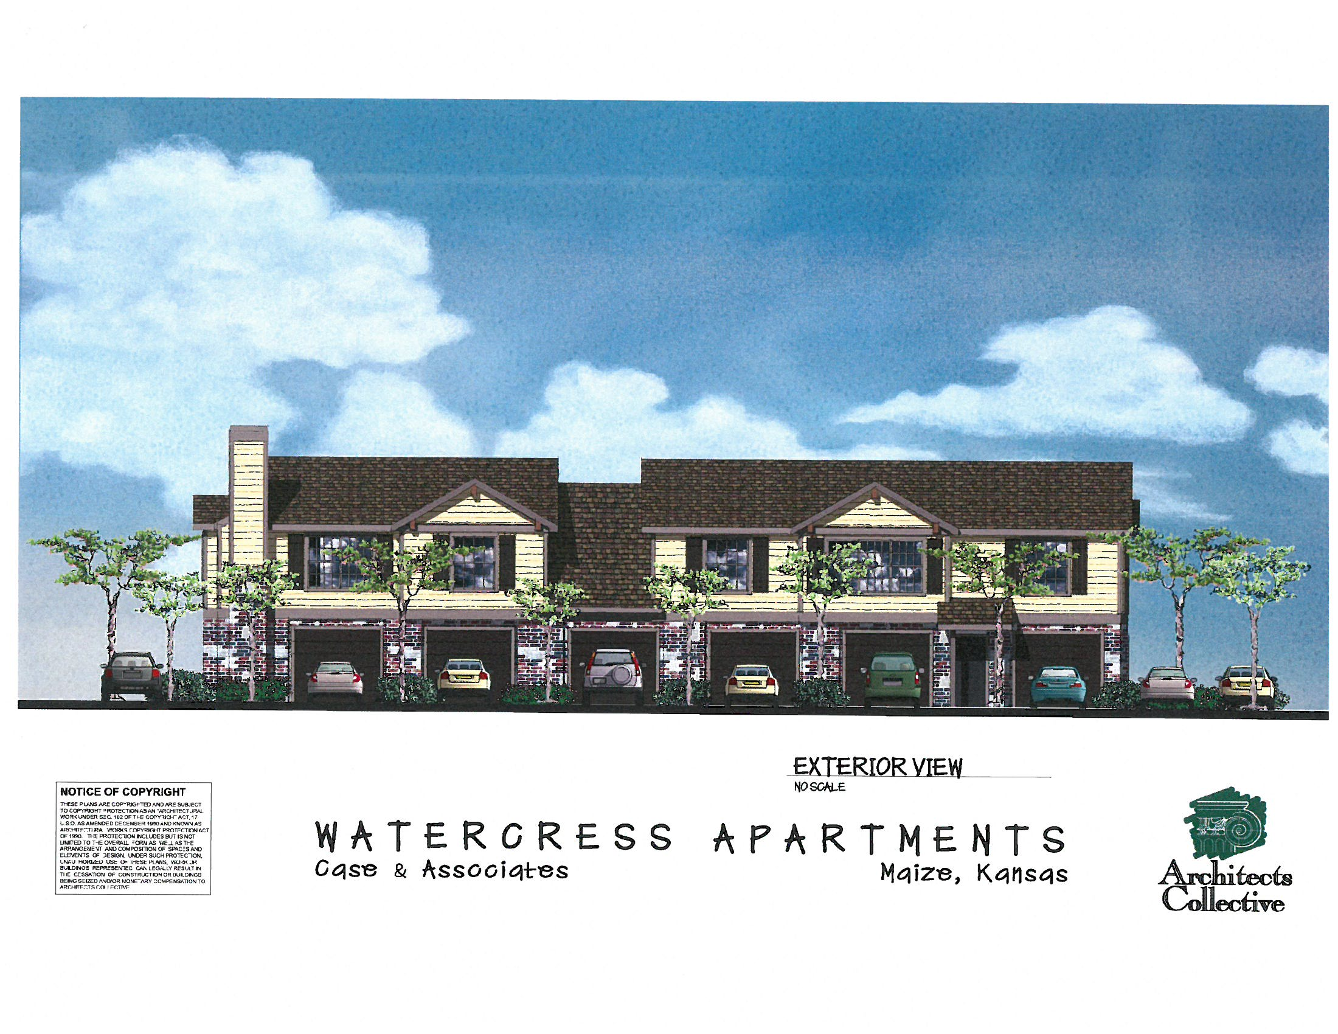
Garages

Slide 29
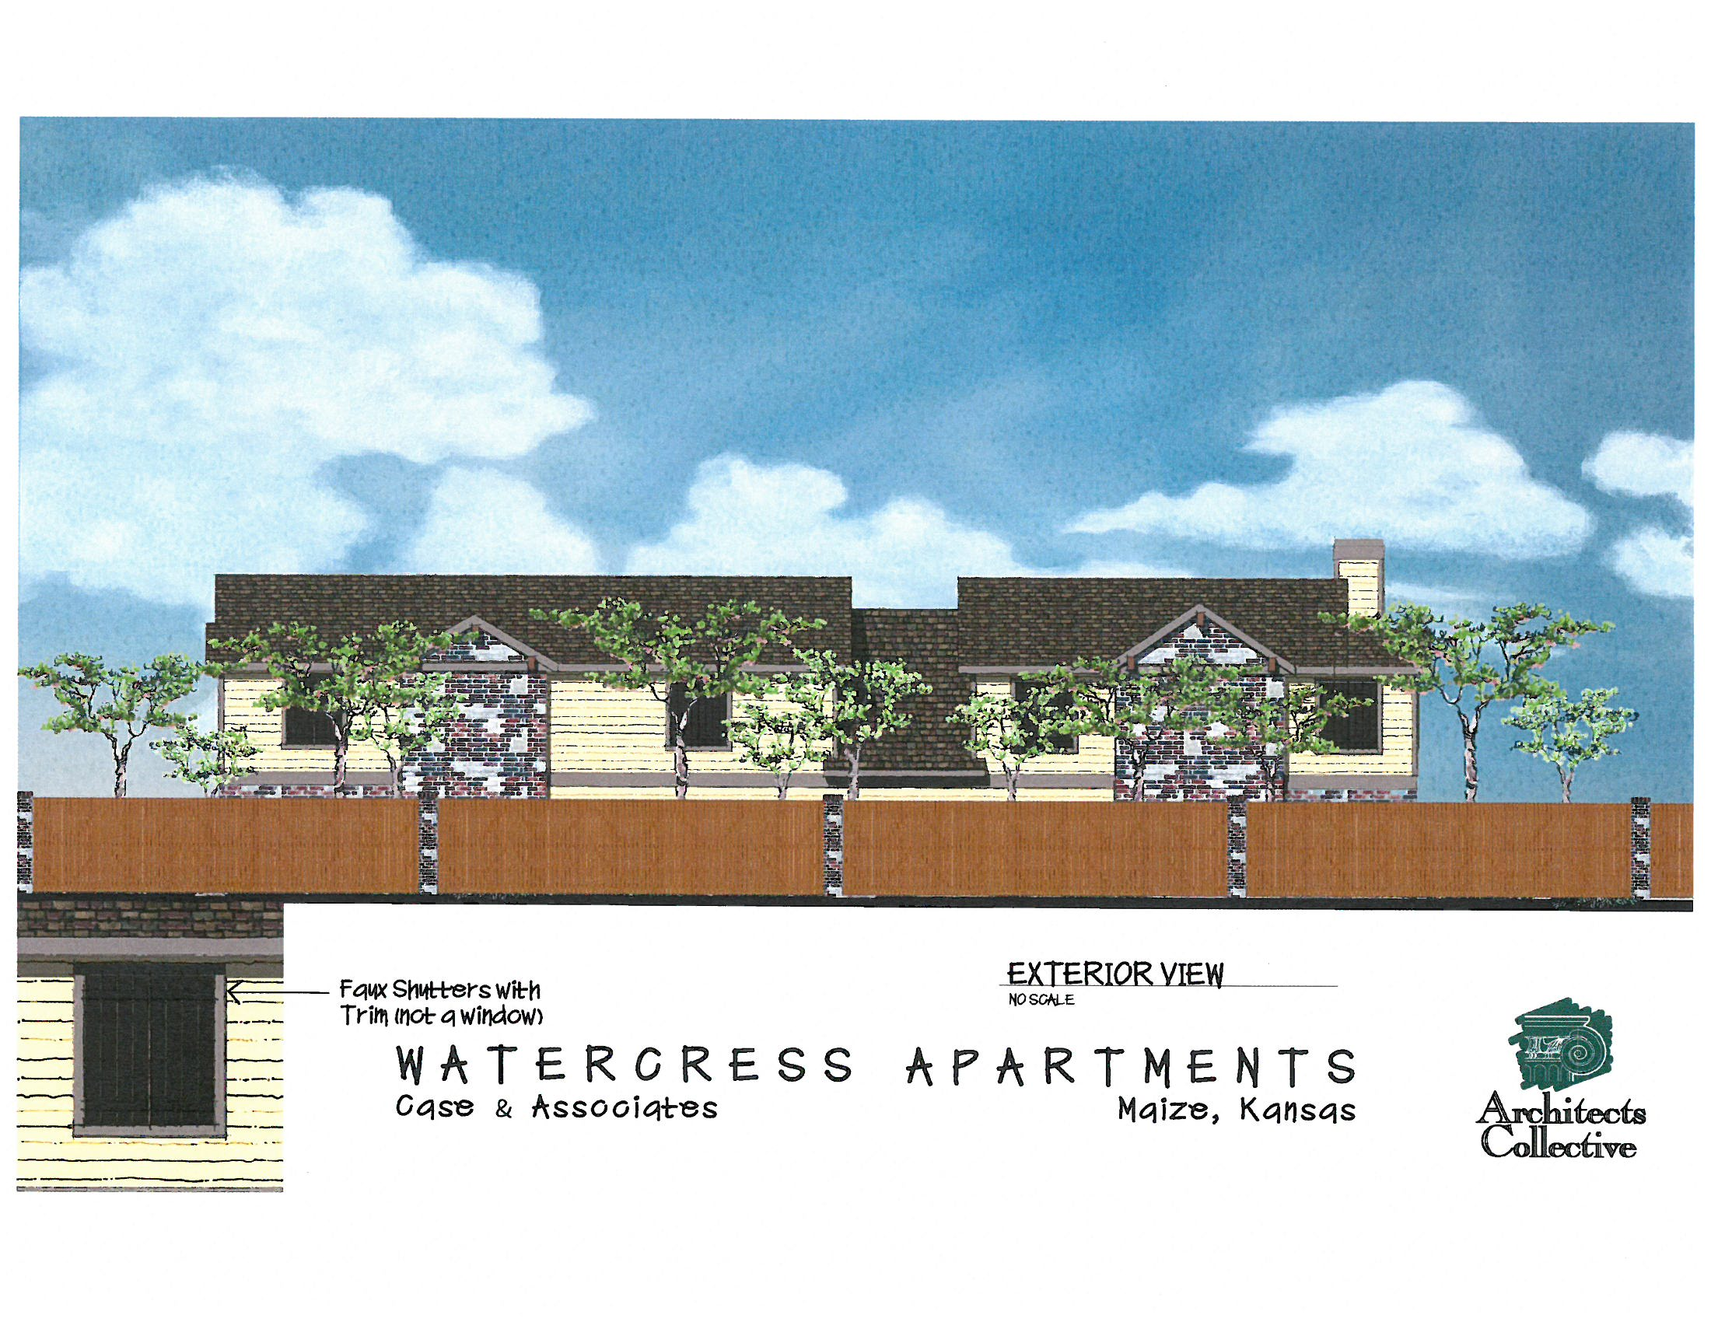
Garages/Back

Slide 30
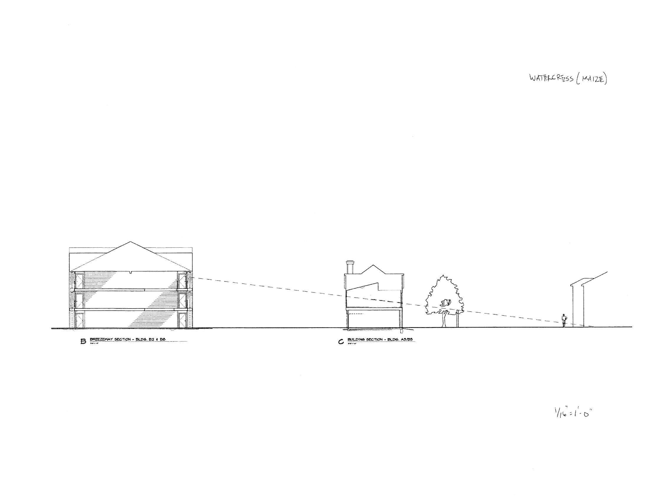

Slide 31
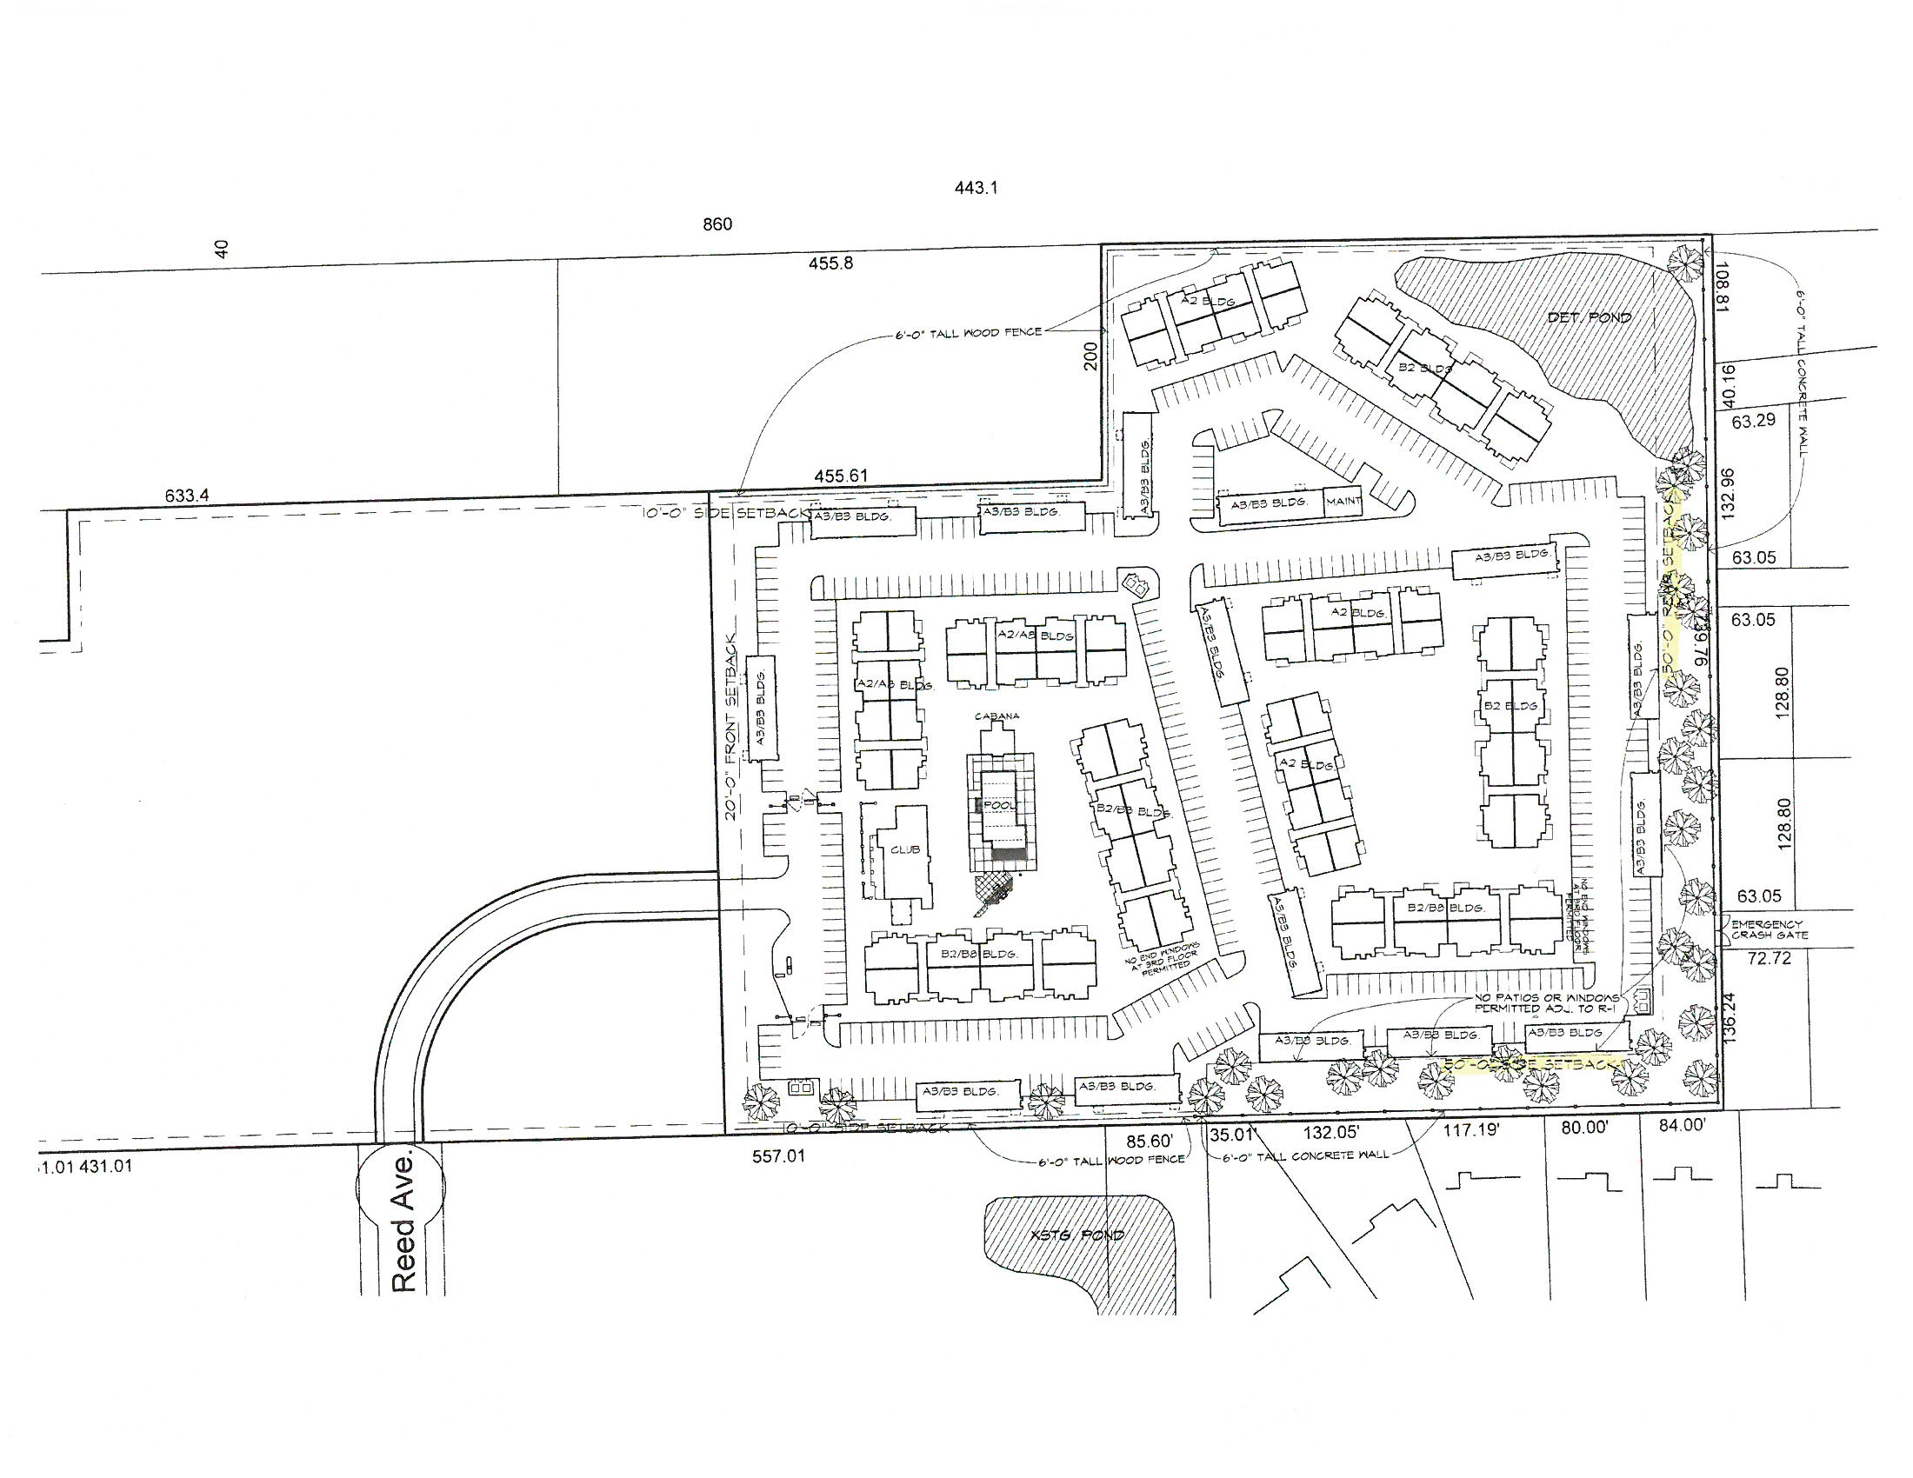
Site Plan

Slide 32
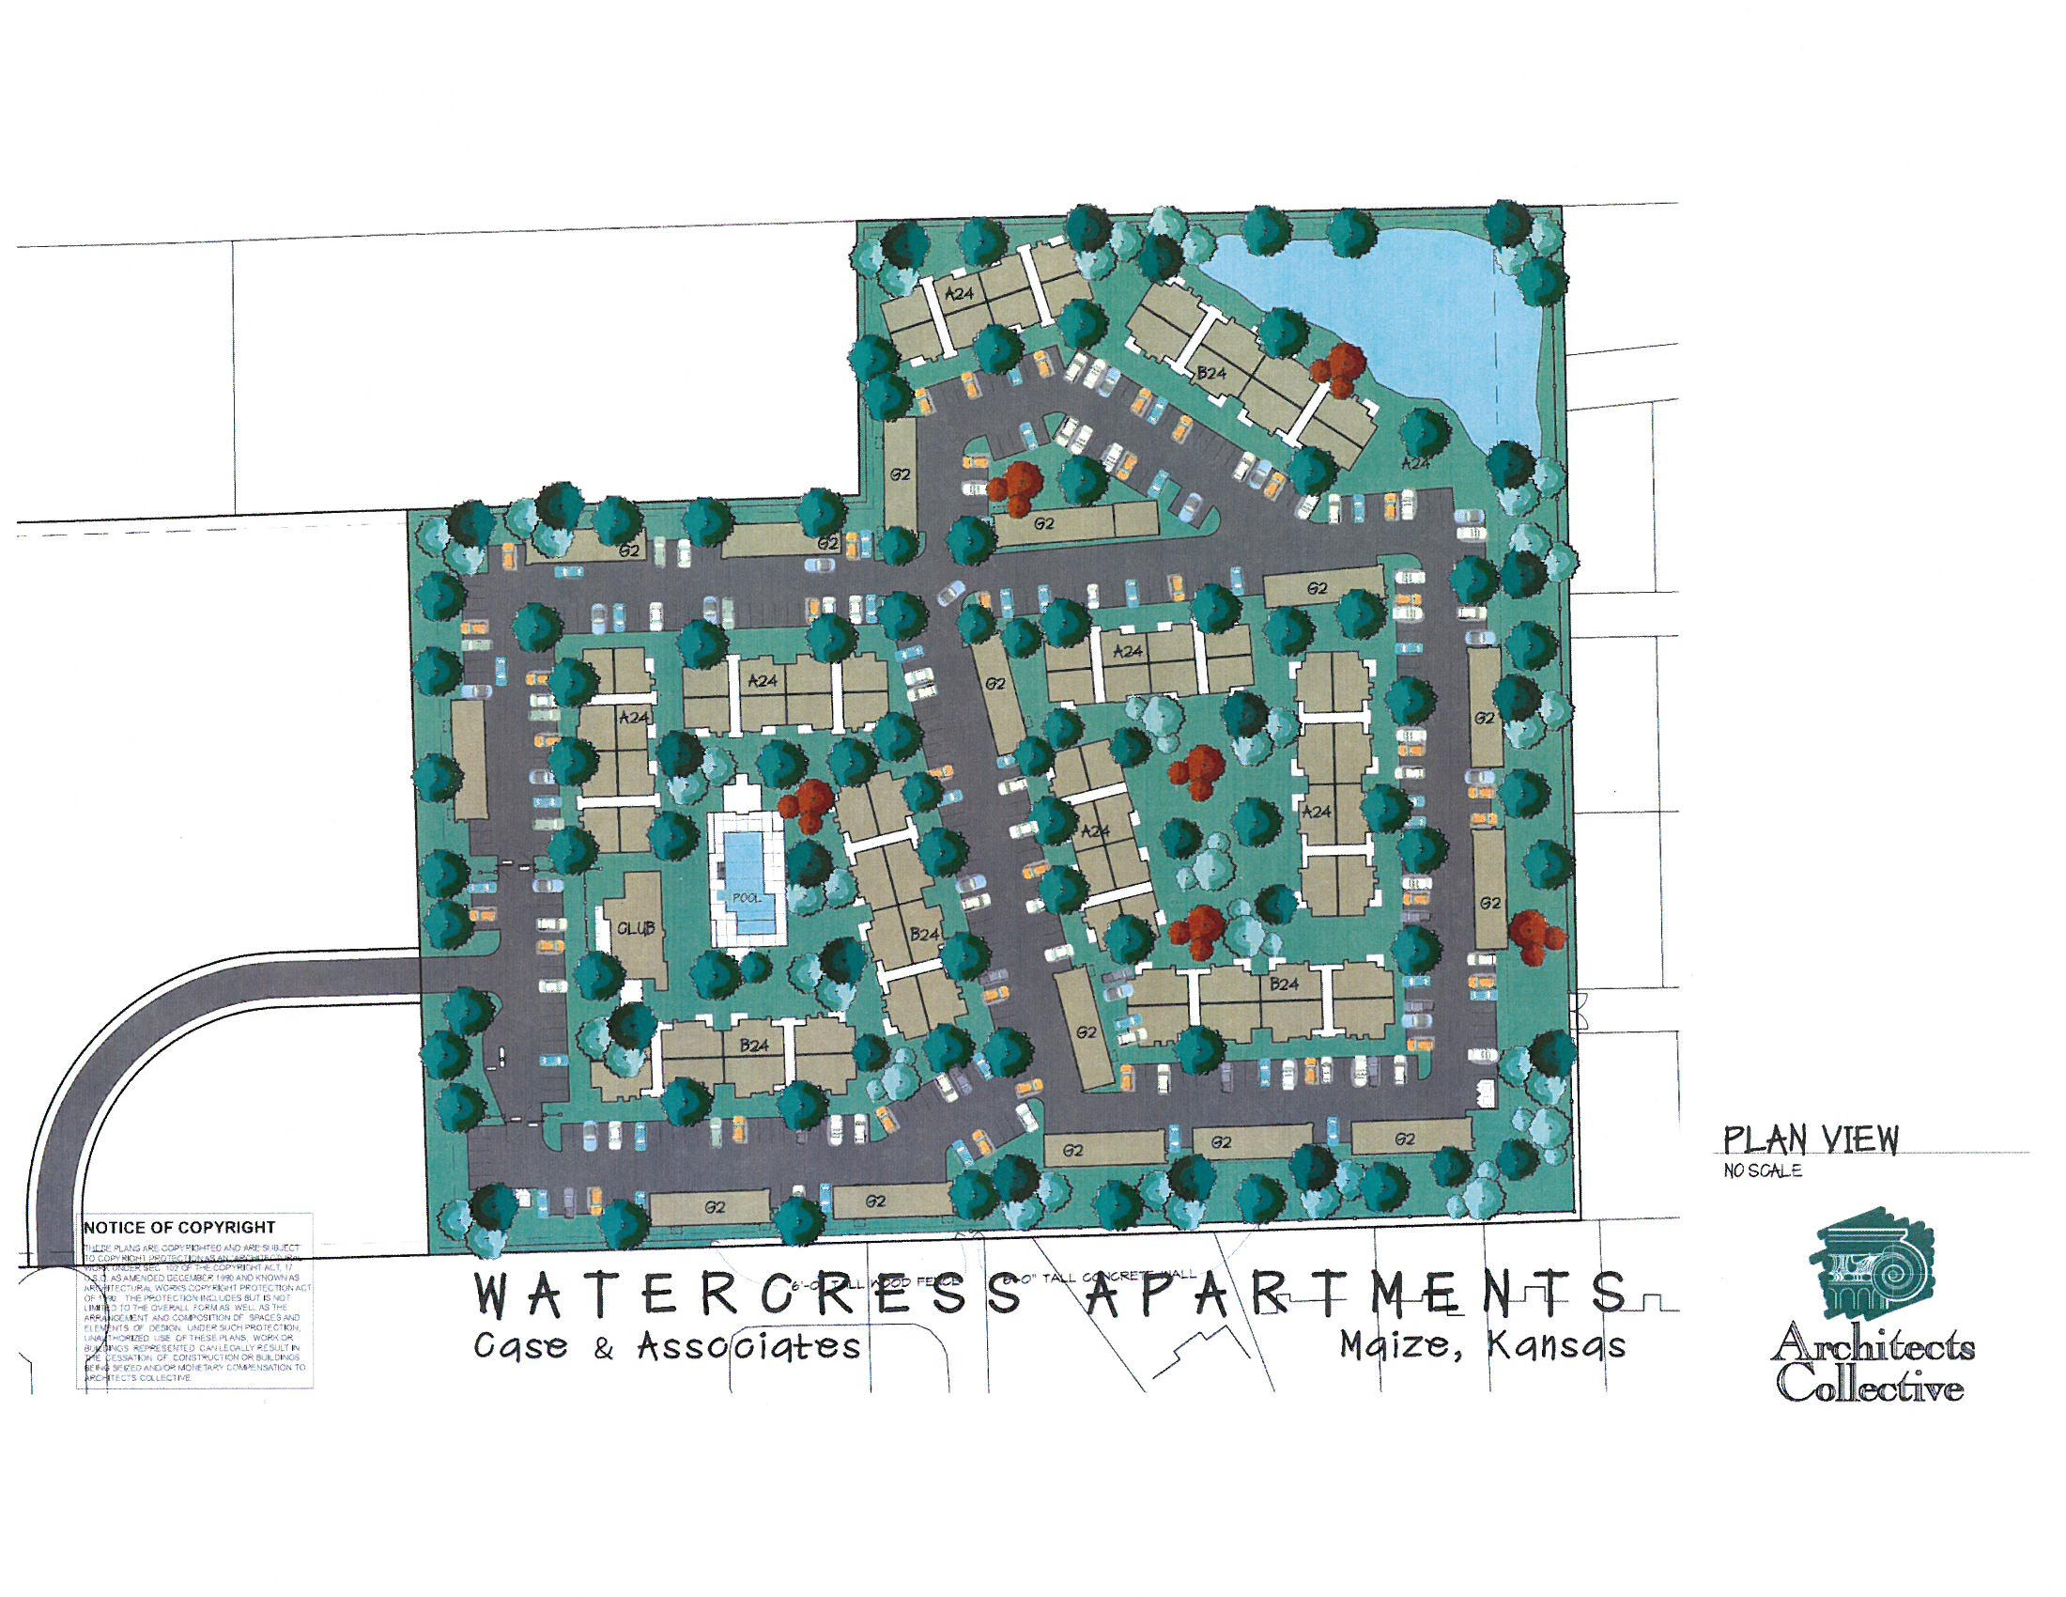

Slide 33
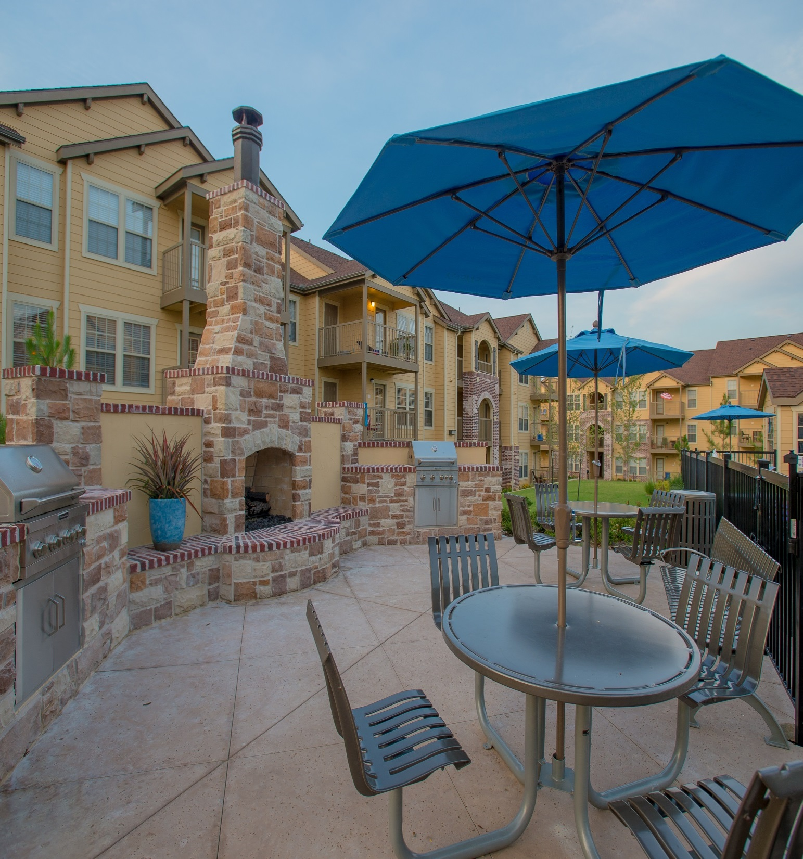

Slide 34
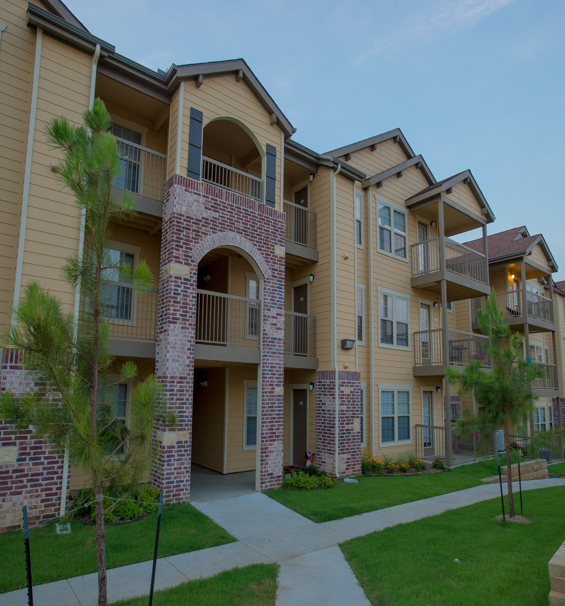

Slide 35
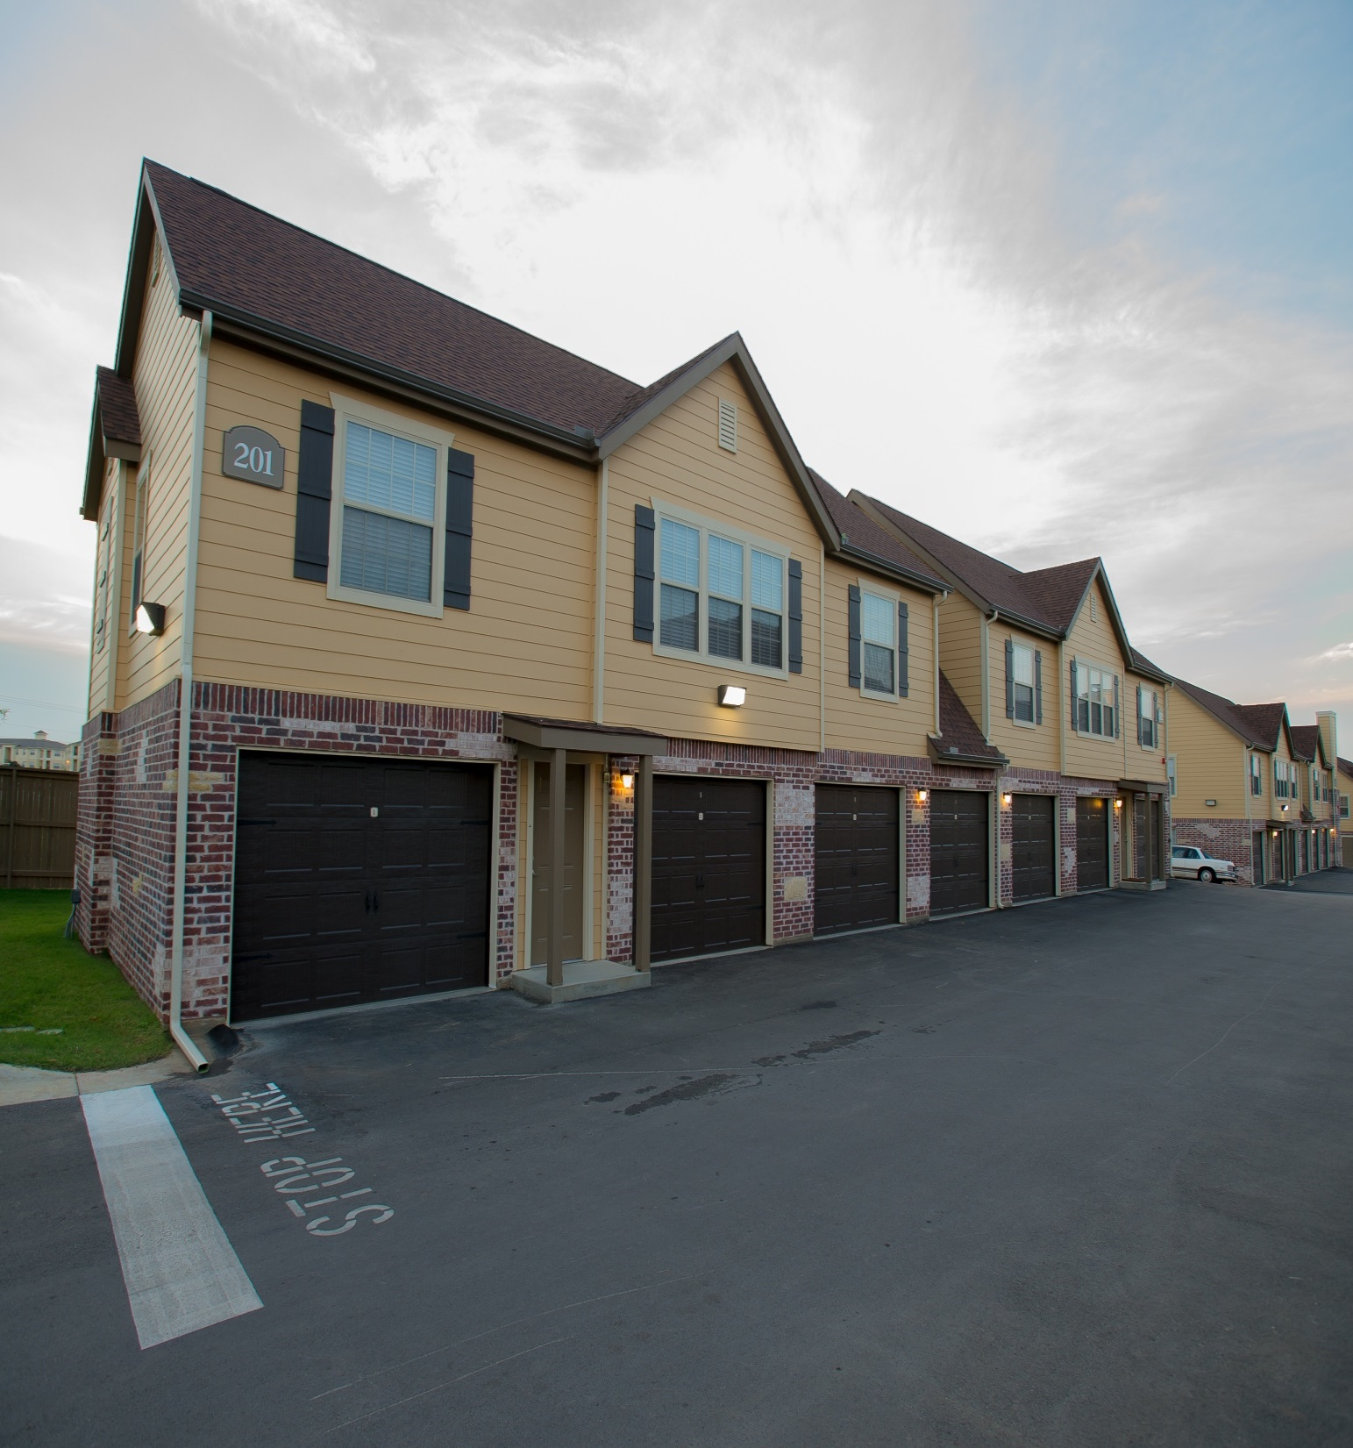

Slide 36
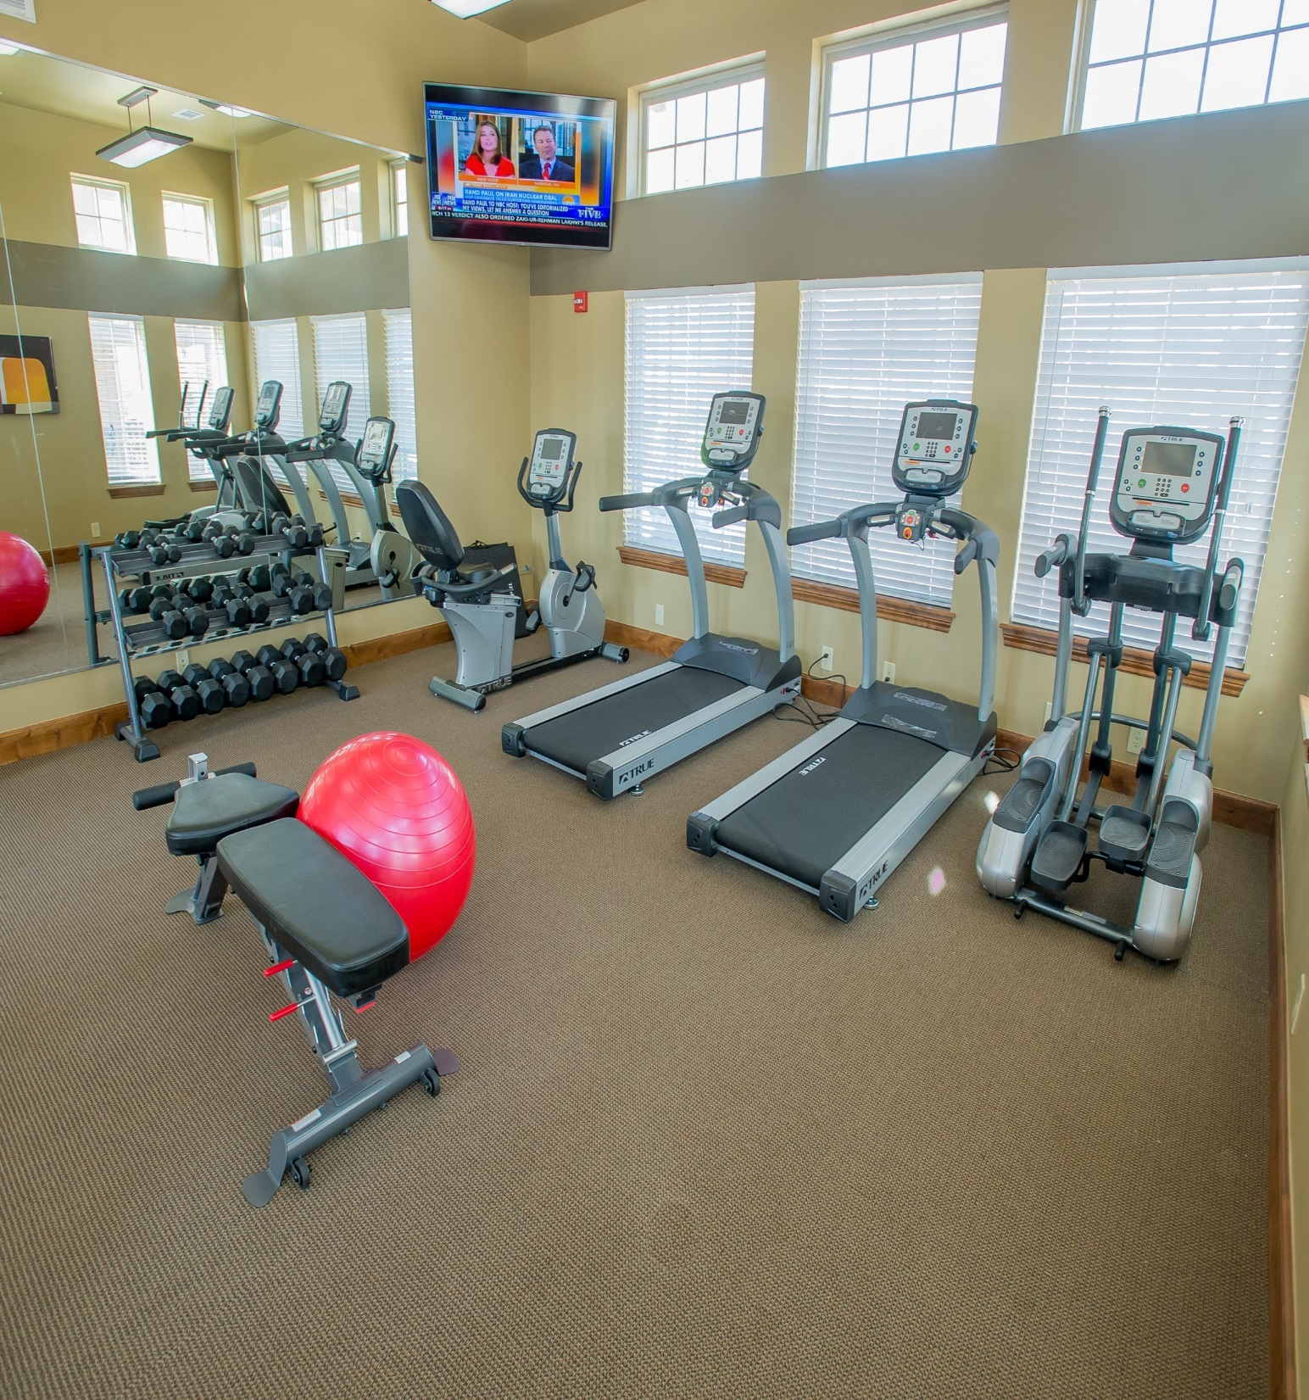

Slide 37
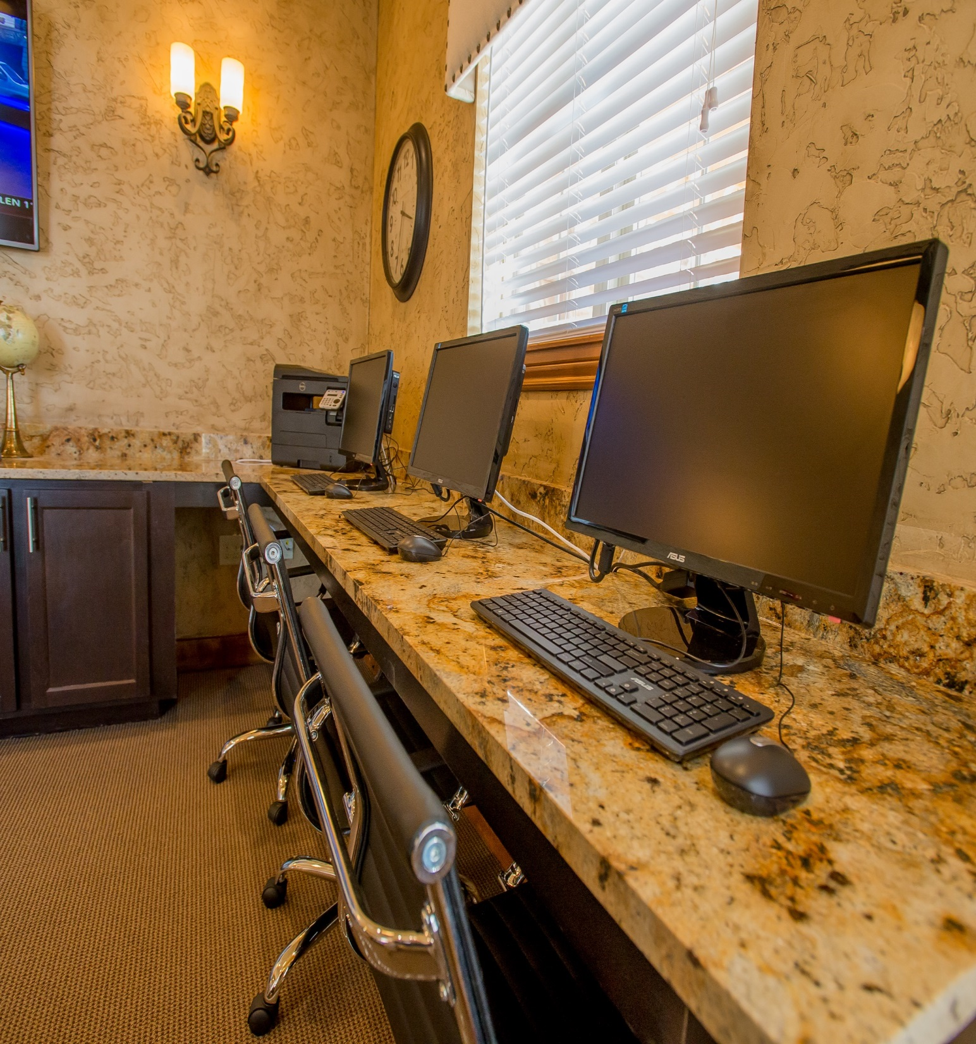

Slide 38
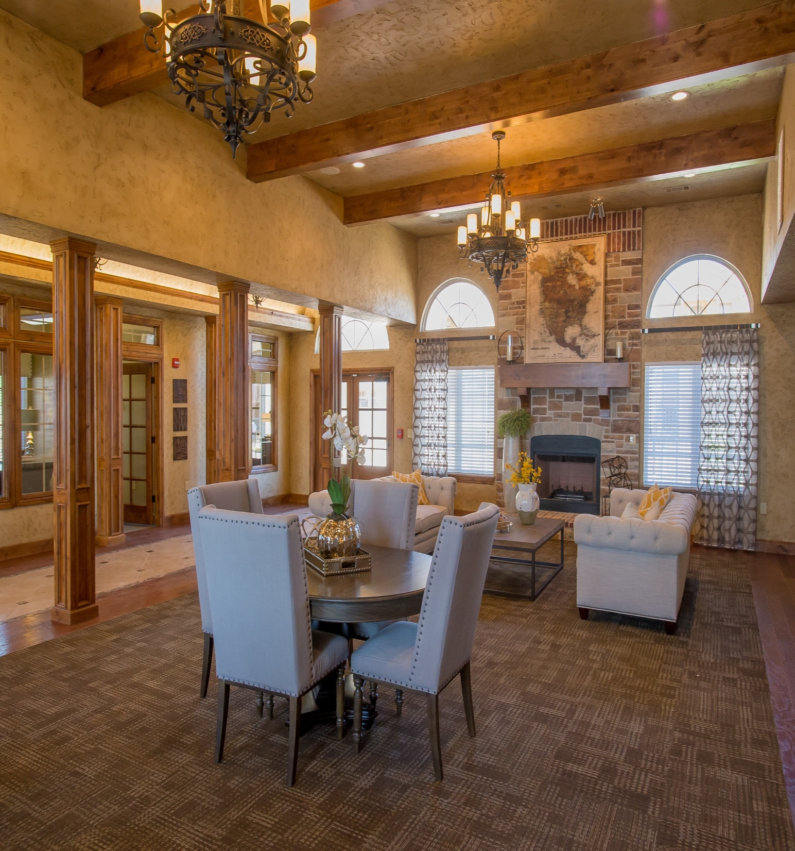

Slide 39
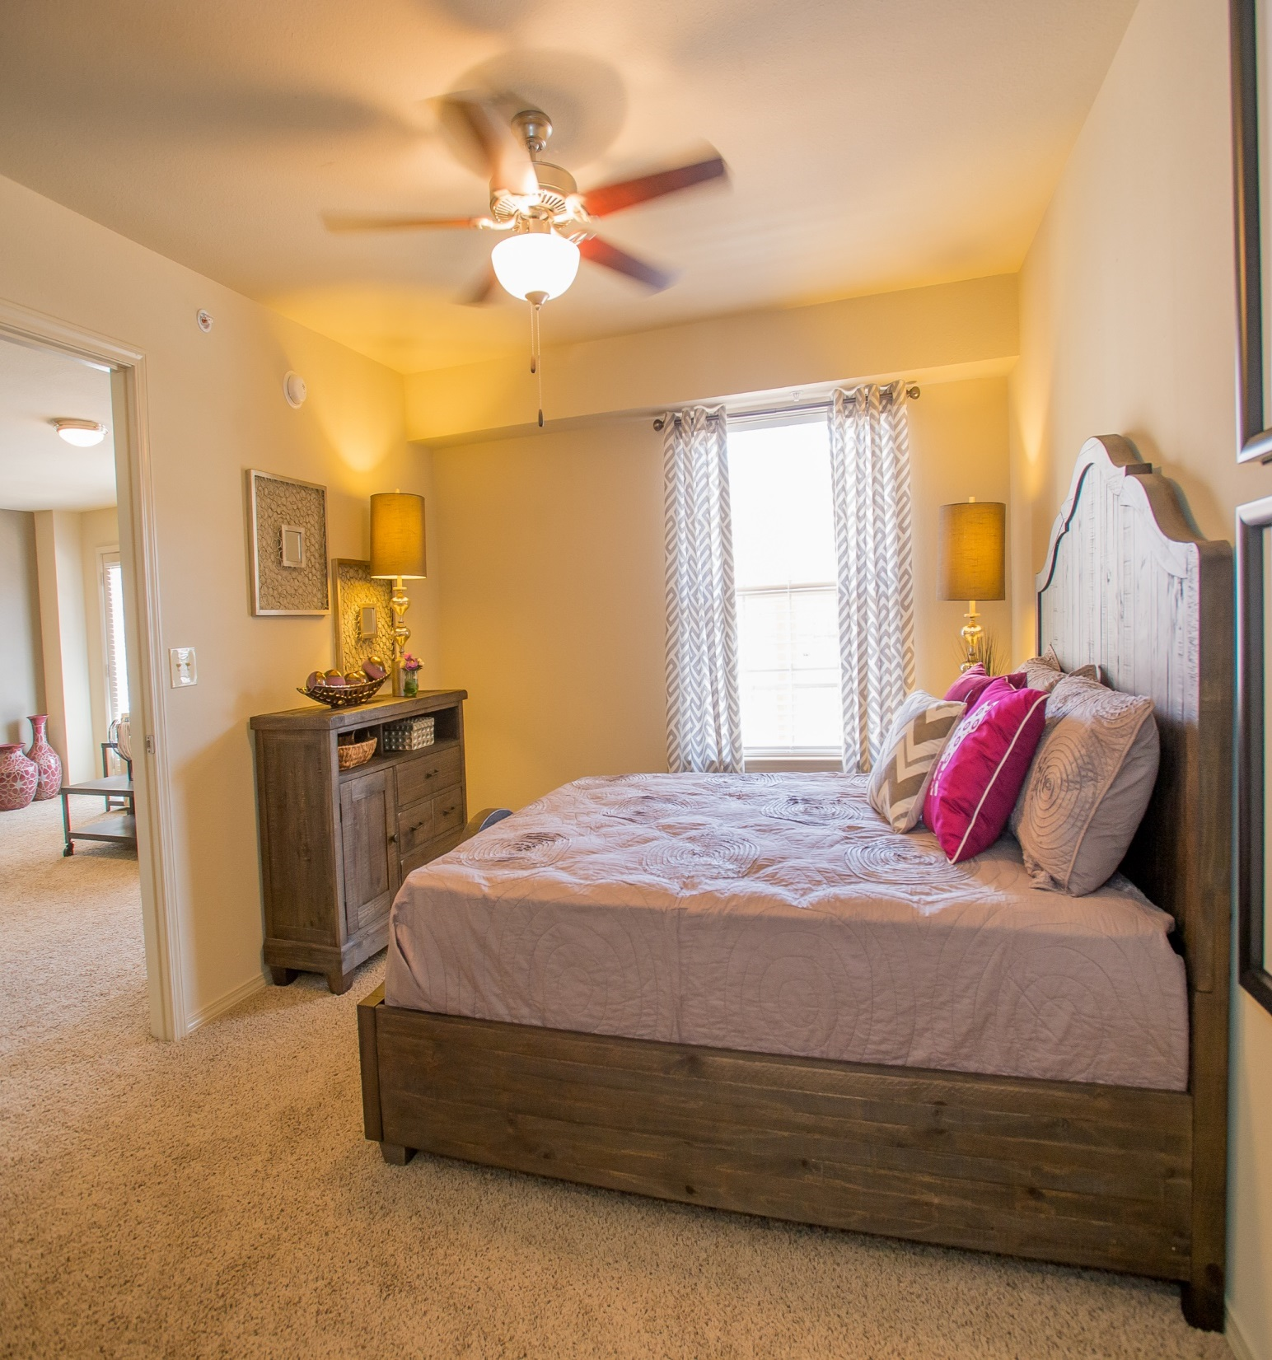

Slide 40
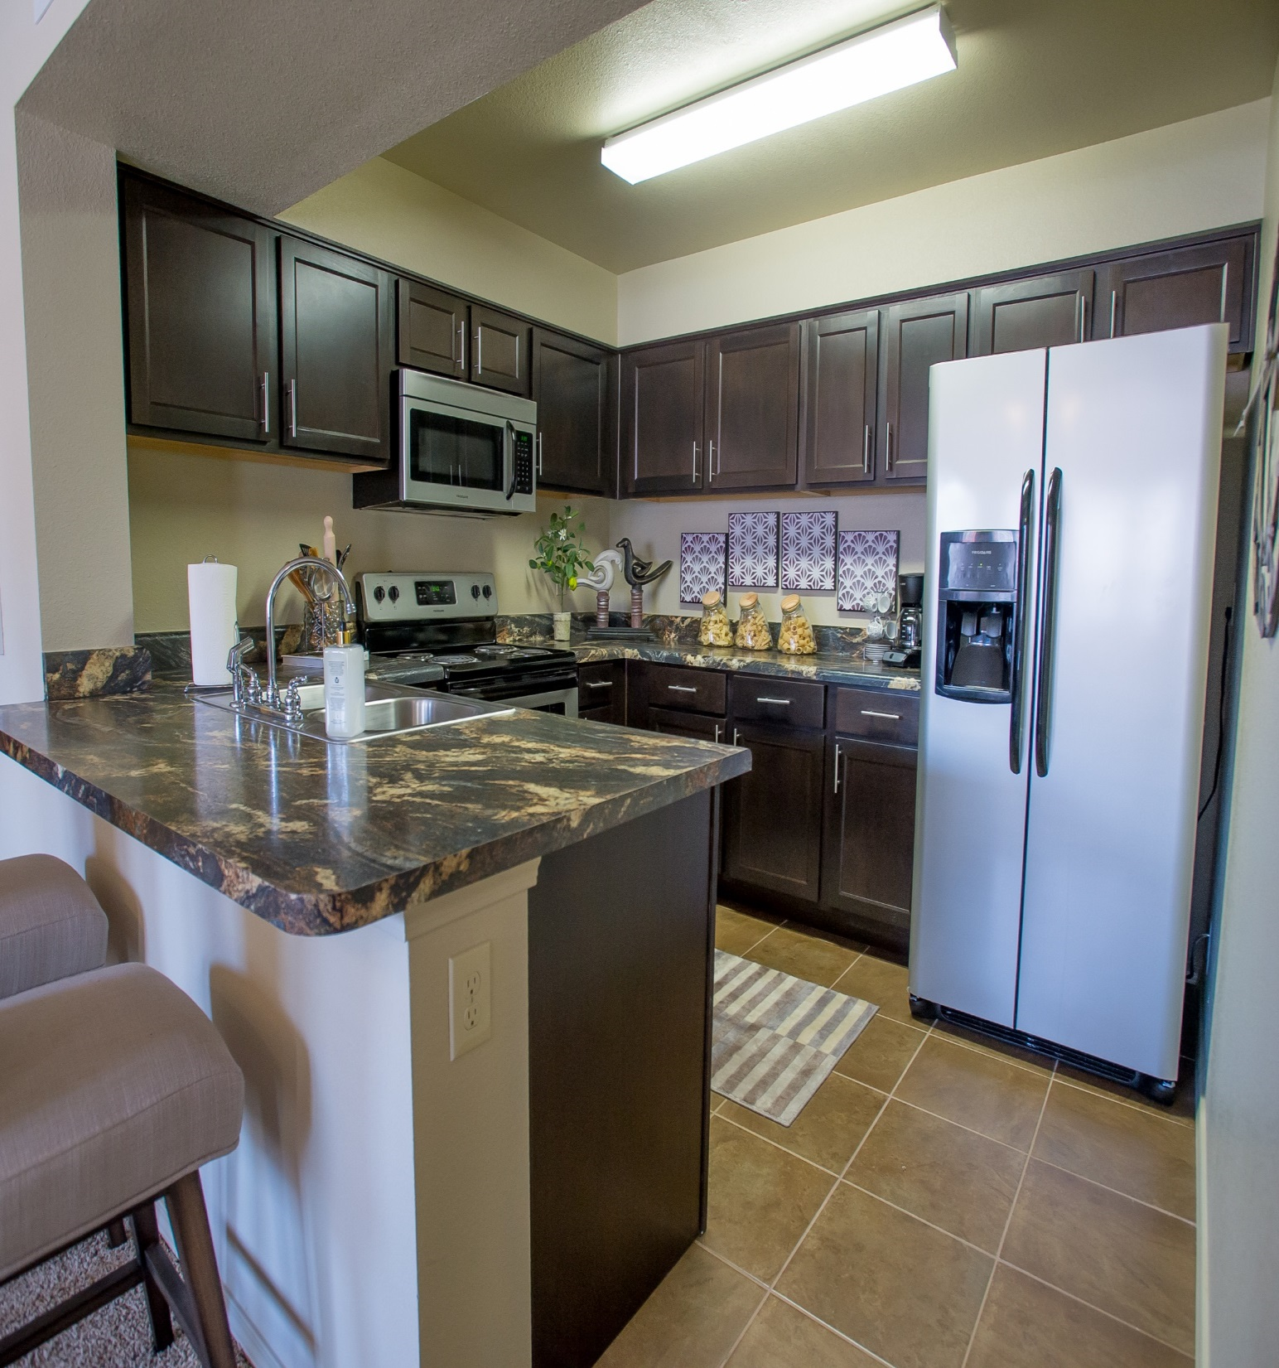

Slide 41
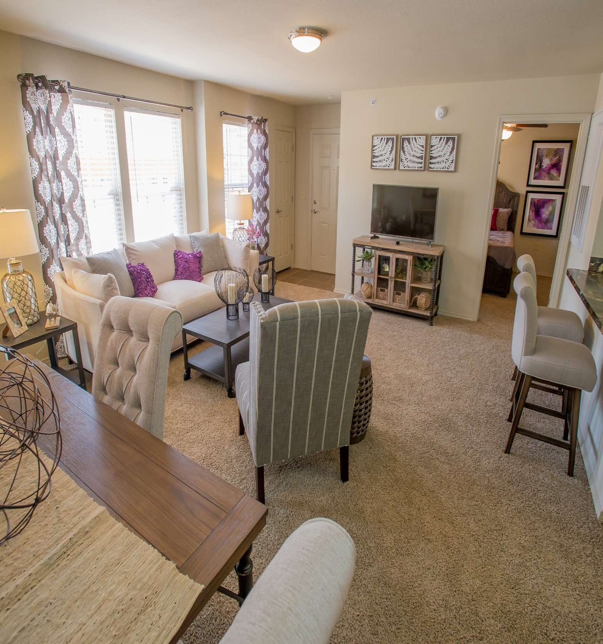

Slide 42
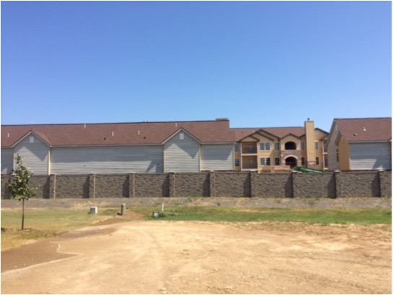
Fence Design

Slide 43
9) Reports

Slide 44
Police

Slide 45
Public Works

Slide 46
City Engineer

Slide 47
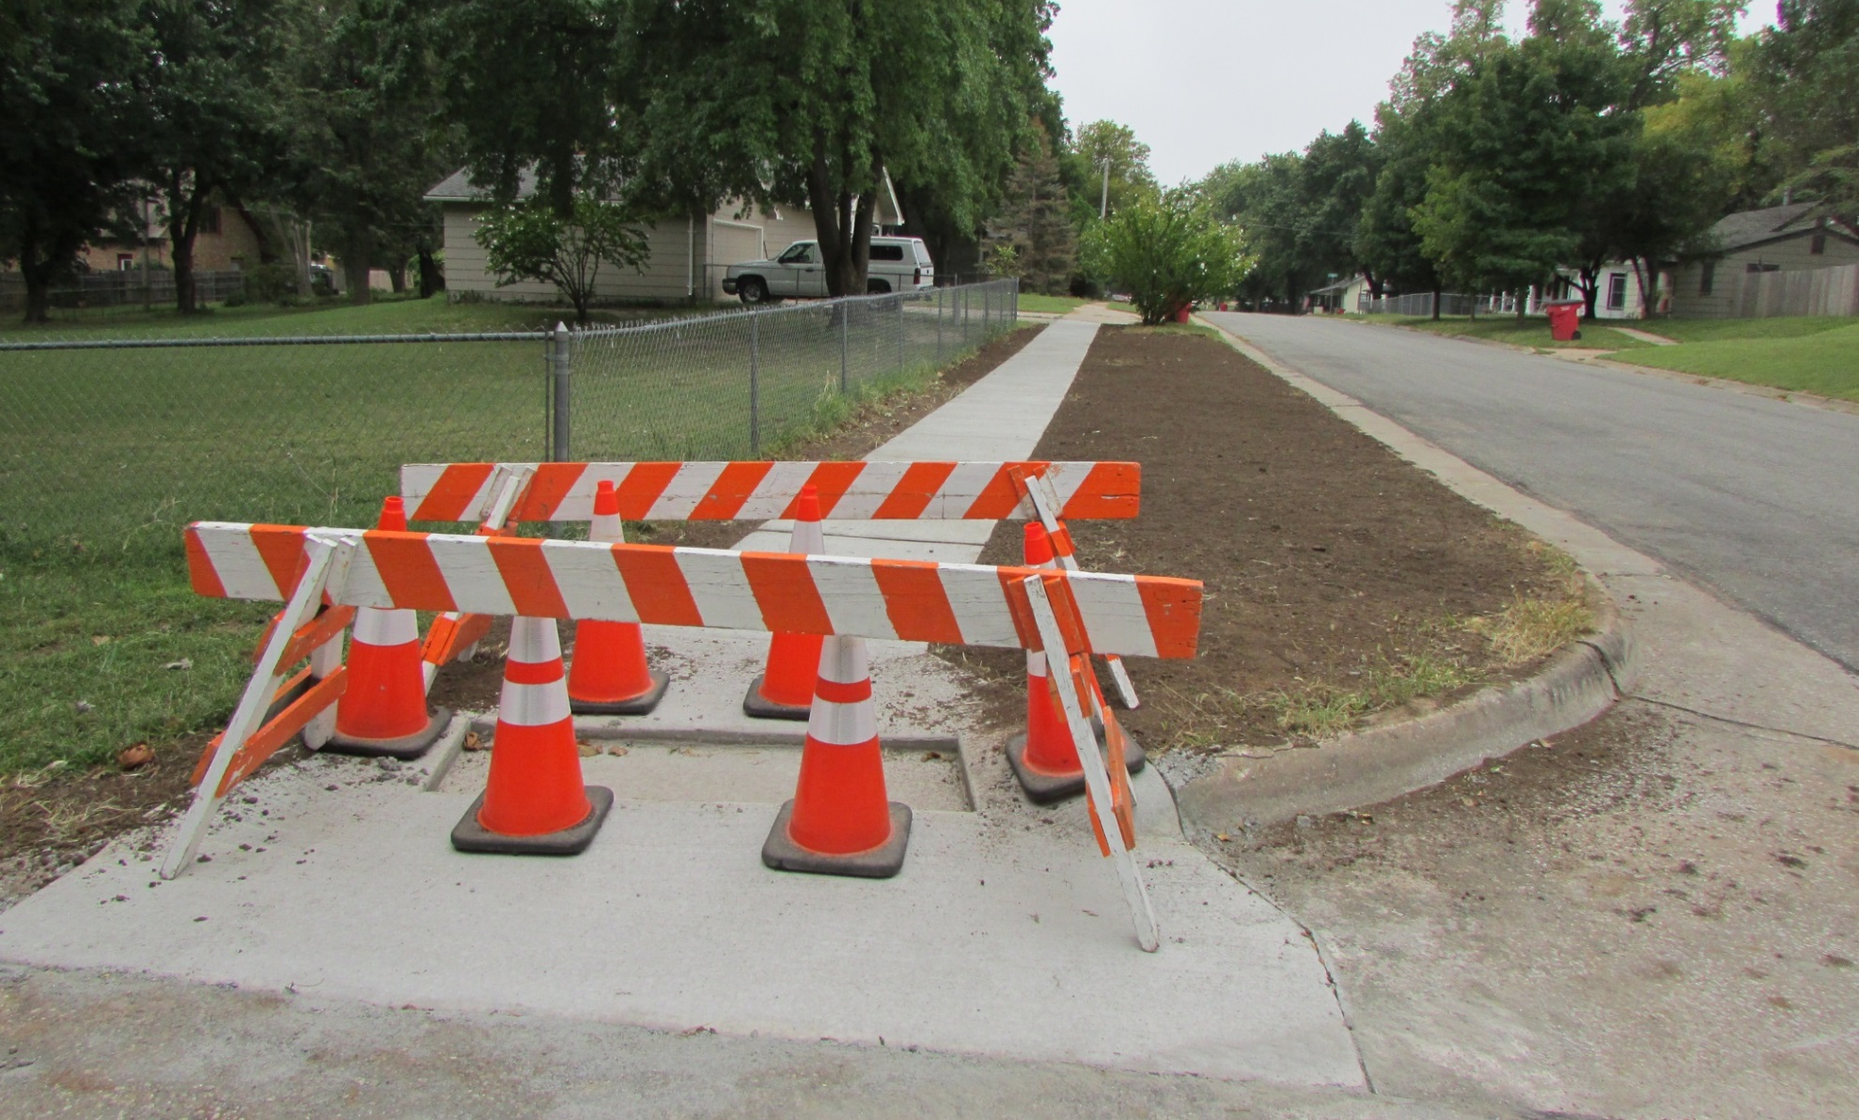
Sidewalk on King Street

Slide 48
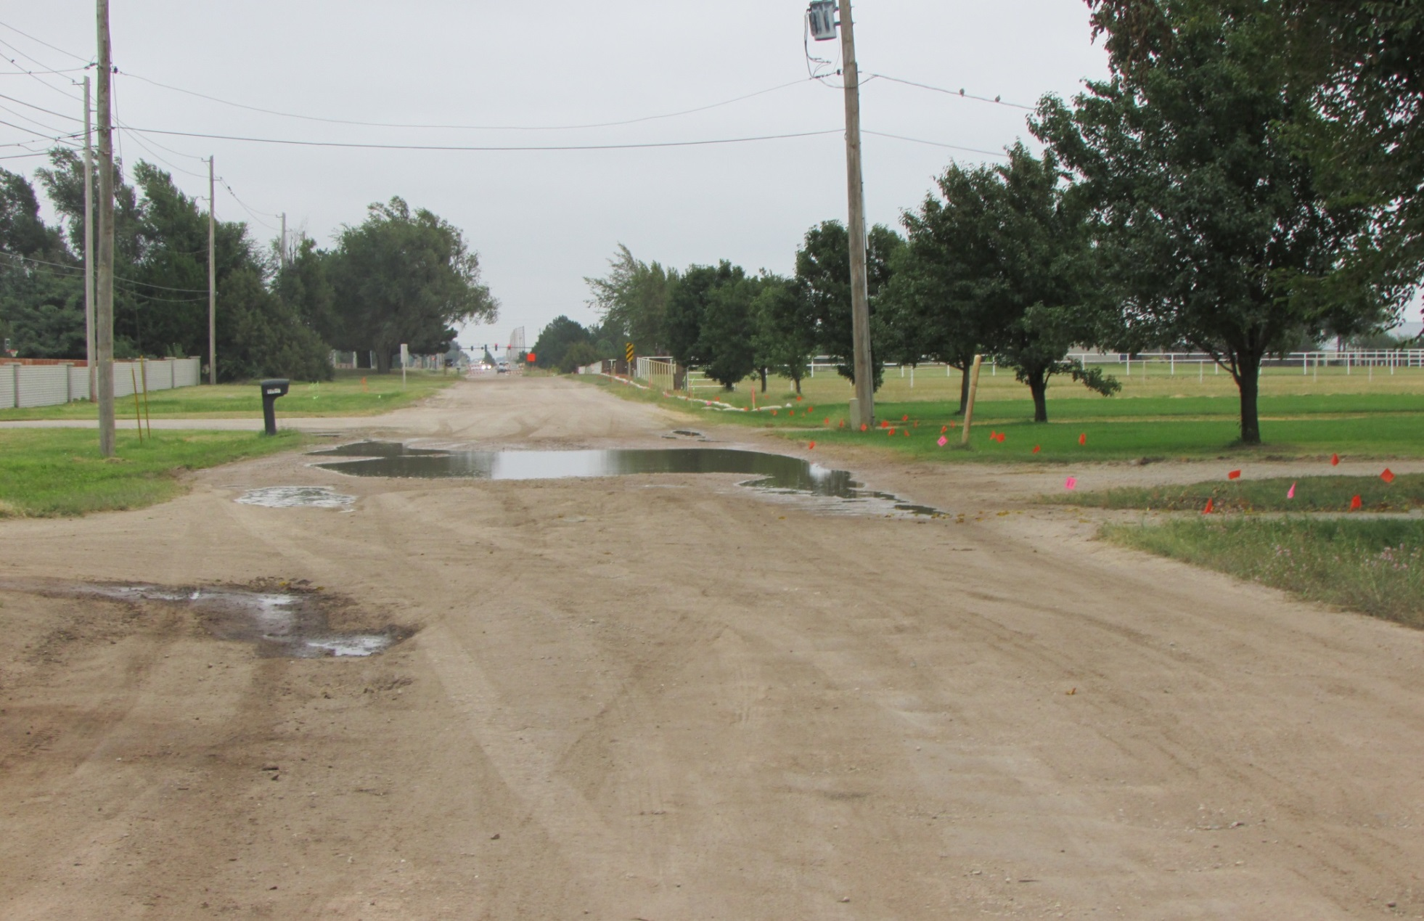
37th Street

Slide 49
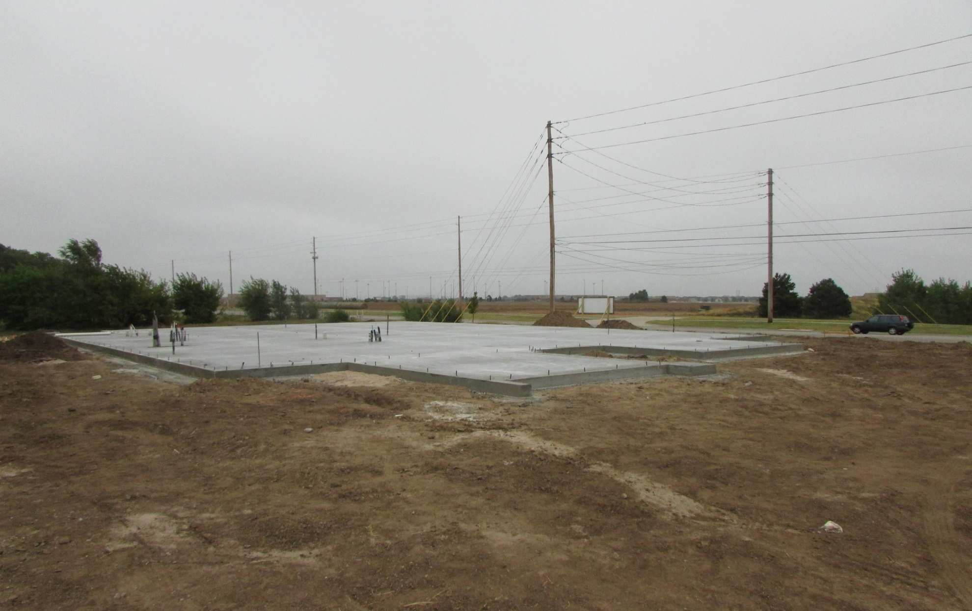
Busby, Ford and Reimer

Slide 50
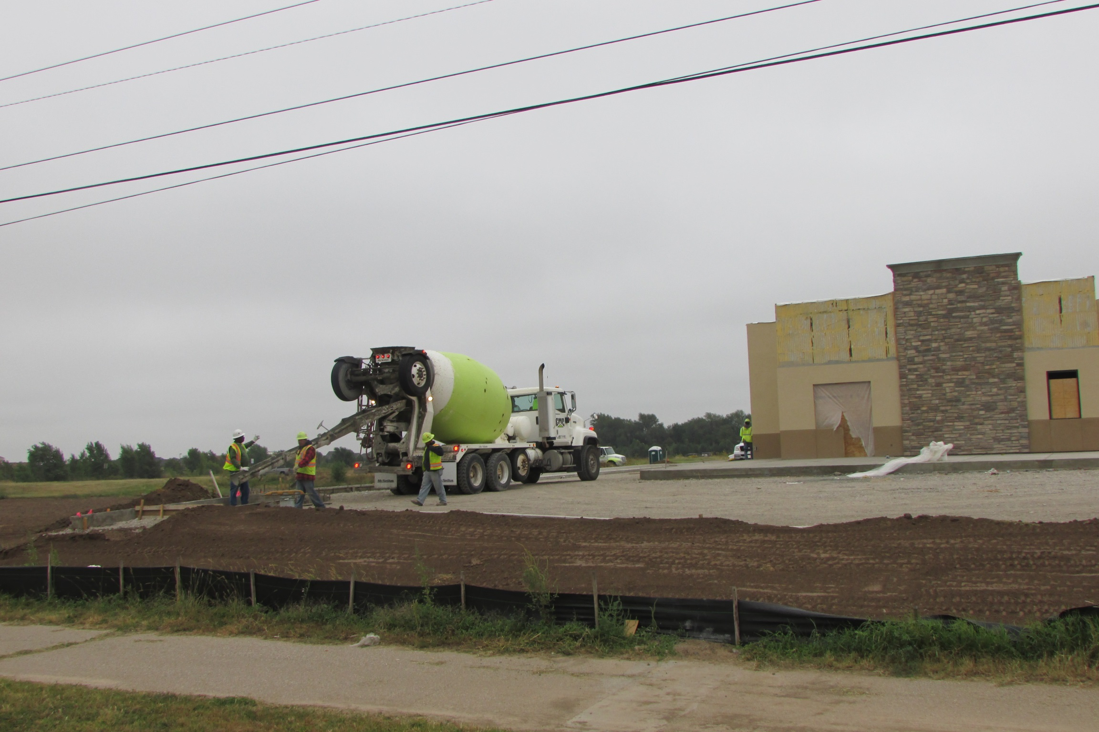
Dairy Queen

Slide 51
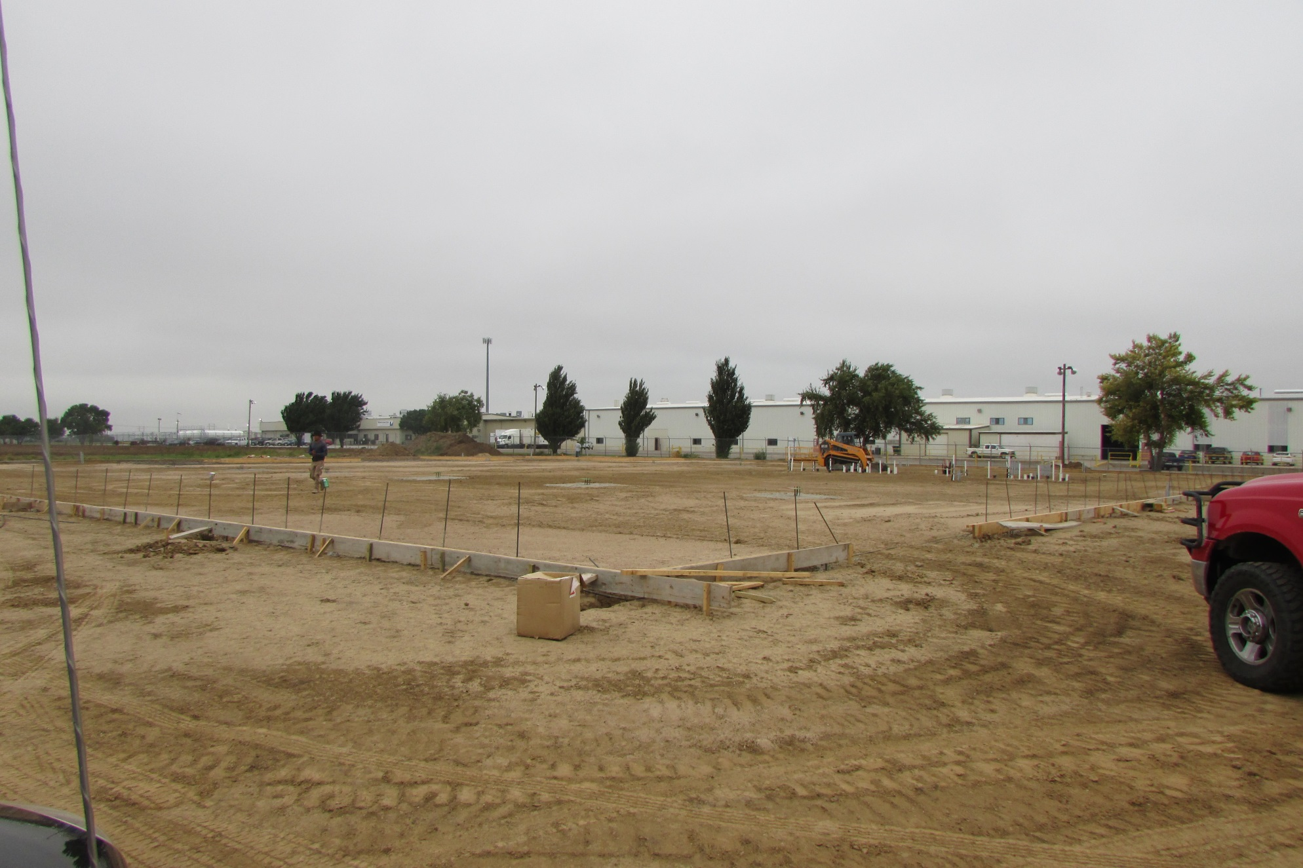
Aero Tech

Slide 52
Planning Administrator

Slide 53
City Clerk

Slide 54
Legal

Slide 55
Operations

Slide 56
Mayor’s Report

Slide 57
Council Member’s
Reports

Slide 58
10) Executive Session

Slide 59
11) Adjournment

Slide 60

MAIZE CITY COUNCIL
REGULAR MEETING
AUGUST 17, 2015

